Slide 1



Data Visualization
Using Power BI
Anish Mahapatra | 31 January, 2023

Slide 2

Agenda
01
Introduction
02
What is Data Science?
03
The Fundamentals of Power BI
04
Best Practices for visualization
05
Tools & Technologies in Data Science
06
Demo on Power BI – Storyboarding & Visualization
Q&A Session

Slide 3












Topic 1 of 6
Introduction: Am I worth your time?
Senior Data Scientist
LinkedIn: www.linkedin.com/in/anishmahapatra Medium: anishmahapatra.medium.com Website: www.anishmahapatra.com
GitHub: www.github.com/anishmahapatra
Q. How to get into Data Science?
A. Simple, ask a real-world Data Scientist.

Slide 4



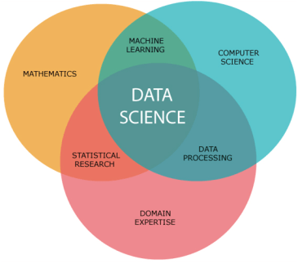
Topic 2 of 6
What is Data Science?
01
02
03
Mathematics
Business
Technology
Understanding the fundamentals of Data Science requires mathematics
Business is the core of every Data Science problem
Evolving technology is what keeps Data Science ahead of every other industry
Notes:
In Industry 3.0, we automate processes using logic processors and information technology. These processes often operate largely without human interference, but there is still a human aspect behind it. Where Industry 4.0 comes in is with the availability and use of vast quantities of data on the production floor.

Slide 5
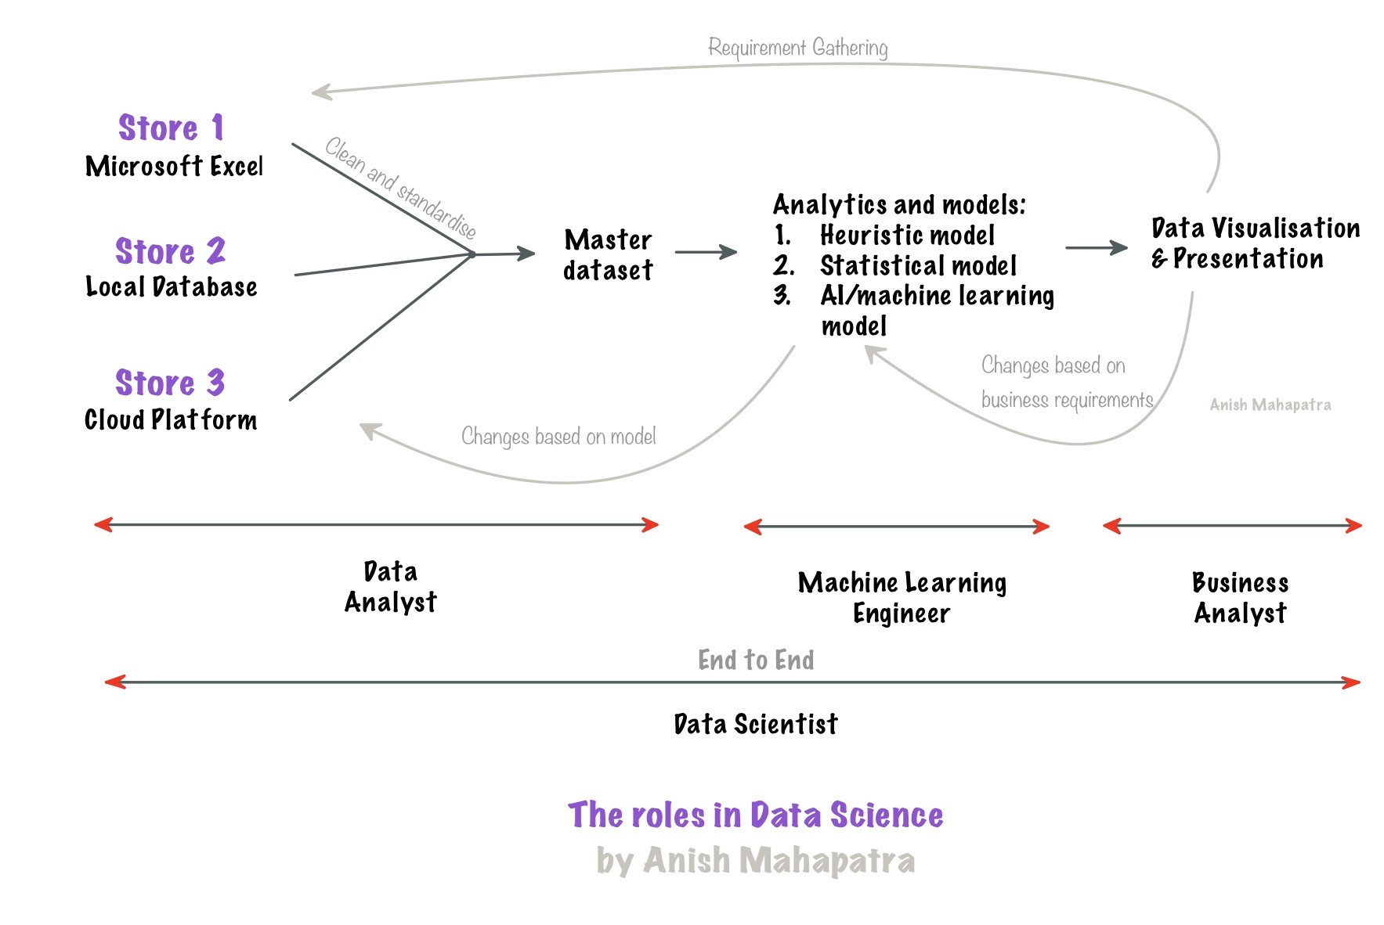
Topic 2 of 6
What is Data Science?

Slide 6




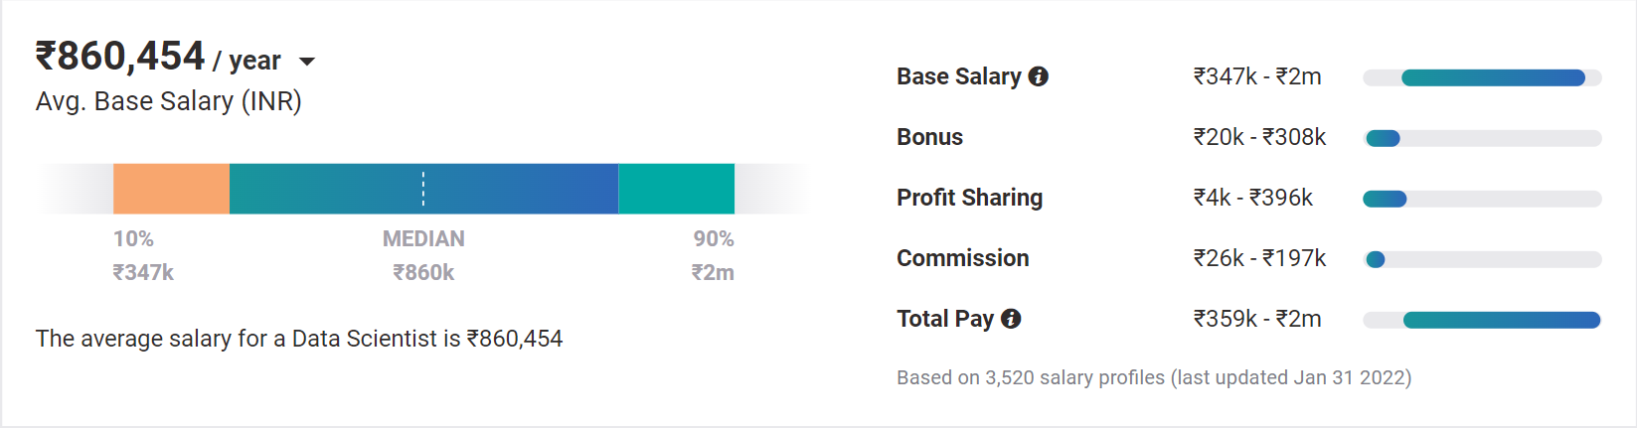
Topic 4 of 6
Why choose Data Science?
01
02
03
Relevance in the future
Business & Technology
Industry-Agnostic
Companies are building and growing in Data and it is the future.
Data Science is a combination of Business, Math and Technology, so growth can be in business / technology
Use your existing knowledge / domain / technology expertise with a data-edge
04
Extremely High Market Demand
Supply-Demand mismatch means companies are willing to pay more
Notes:
Source:https://www.payscale.com/research/IN/Job=Data_Scientist/Salary

Slide 7
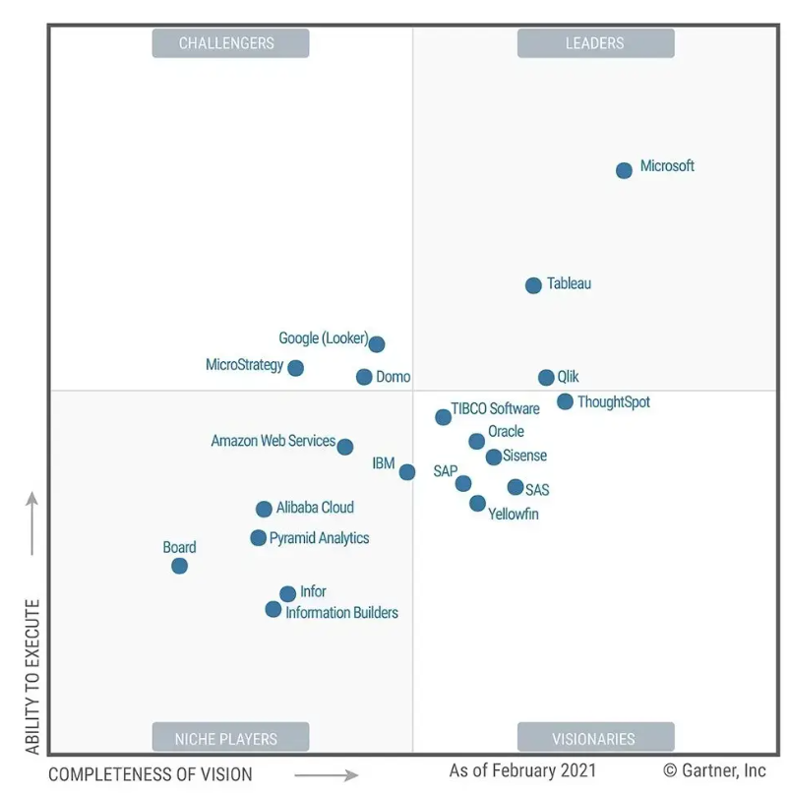
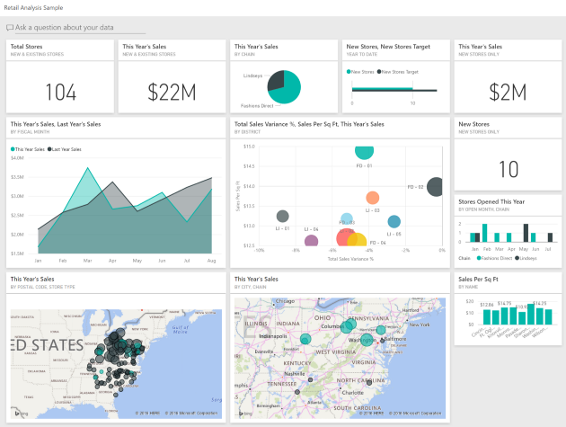
Topic 4 of 6
The Fundamentals of Power BI - Definition
Power BI is an interactive data visualization software developed by Microsoft with a focus on Business Intelligence (BI).
Power BI has been named as the Gartner Market Leader for 14 consecutive years, it is one of the best visualization tools
It has the ability to create a variety of visualizations from multiple sources and is used by many Fortune 500 organizations
Notes:
Source: https://www.cisco.com/c/en/us/products/security/machine-learning-security.html#~how-ml-helps-security

Slide 8





Topic 4 of 6
The Fundamentals of Power BI - Components
01
02
03
Multiple Data Sources
Transformation of Data
Storytelling & Multiple Visualizations
Power BI can pull from multiple sources locally, on native servers and even multiple cloud platforms
Data can be cleaned and transformed in Power BI in Batch mode or even in near real-time
It has the largest library to support visualizations of all kinds on Windows as well as on the Web (Power BI Store)
04
05
Visualizations on the Cloud (Power BI Service)
Sharing, Scaling, Security and Community Support
Power BI dashboards can be shared via a paid service to thousands of users that can view reports and even share and download them
Power BI can scale to multiple users while taking factors such as security and information mitigation risk management
Notes:
Source: https://www.cisco.com/c/en/us/products/security/machine-learning-security.html#~how-ml-helps-security

Slide 9







Topic 4 of 6
Best Practices for Visualizations
Consider your audience
Avoid Data Clutter
Understanding why the audience uses the dashboard, the metrics that matter, and what are the actionable insights present
Only the relevant information should be presented to the individual user. Avoid showing all information to everyone, this creates data clutter
Think about the Flow and Layout
Avoid poor labelling
and provide context
The story to be told, the layout of the dashboard, the areas of focus, helpful metrics, and how to maximize space
The audience should be able to understand the naming as well as have a help section for the FAQs to maximize the usage of time
Accent the most
important information
Select the right
visualizations
The most important elements should have a clear focus and should not be cluttered. It should follow a solid storyboarding process
The selection of visualizations is critical to the success of the usage of the dashboard. The color scheme, the tooltips and the data subset

Slide 10




Topic 4 of 6
Power BI Best Practices
Security
Enable RLS – Row-level security, use certified custom visuals, categorize report by business impact
Performance
Limit number of visualizations, remove unnecessary interactions, limit complex measures, use star schema, import only necessary fields, reduce queries, reduce data loaded
Design
Use white or light colors, shorten numbers, use tooltips to provide additional information, use meaningful names, allow users to personalize reports, follow a solid color scheme (logo)

Slide 11















Topic 5 of 6
Tools & Technologies in Data Science
Data Engineer
Machine Learning Engineer
Business Analyst
Data Scientist

Slide 12
Topic 6 of 6
Power BI
The Demo

Slide 13

Data Visualization
Using Power BI
Anish Mahapatra
Let’s Talk!
LinkedIn: www.linkedin.com/in/anishmahapatra
Email: anishmahapatra01@gmail.com

